Slide 1
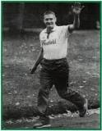
Cliff Young

Slide 2
Early Life
Cliff was the youngest in his family and they lived in Beech Forest in Southwestern Victoria, the family lived on a farm which was approximately 2,000 acres in size with around 2,000 sheep. Cliff would round up the sheep on foot as it was the “easiest” method.

Slide 3
Cliff the Ultramarathon Runner
In the year 1983 Cliff, a 61 year old potato farmer signed up for the Sydney to Melbourne Marathon with the distance of 875 kilometres. He ran at a jogging speed and was shuffling his feet whilst running. He never once rested during the race whilst everyone else would run for 18 hours and sleep for 6 hours a day. The marathon took Cliff 5 days 15 hours and 4 minutes which was 2 days faster than the previous record holder.

Slide 4
Personal Life
Cliff was a vegetarian from birth until death. He lived in his family home with his mother and brother Sid, Cliff was single his whole life until after the race when he met the girl of his dreams, a 23 year old named Mary. He married at the age of 63, the wedding was hosted by the sponsor of the marathon which Cliff had won. Unfortunately five years later the couple got a divorced. During his career he ran about 20,000 kilometres.

Slide 5
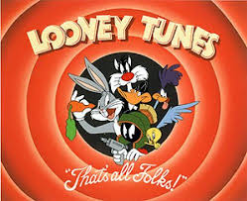
Thanks For Watching!

Slide 6
Bibliography
http://en.wikipedia.org/wiki/Cliff_Young_(athlete)#Early_life

