Slide 1
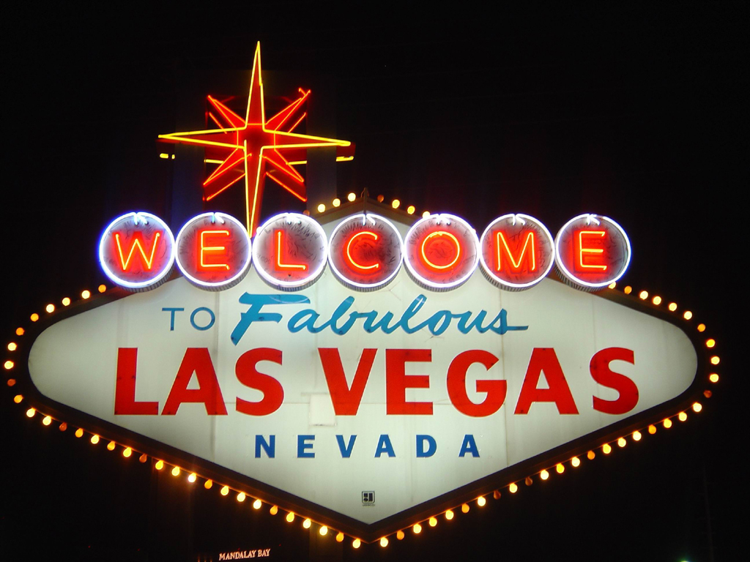

Slide 2
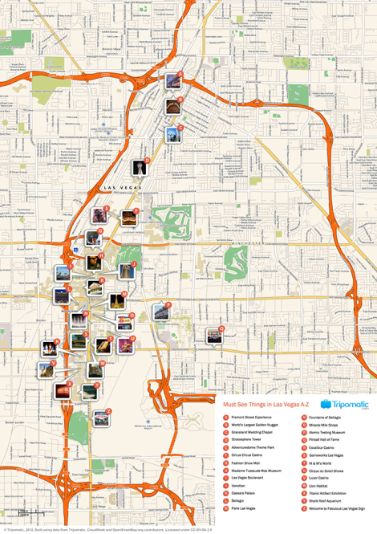
Map

Slide 3
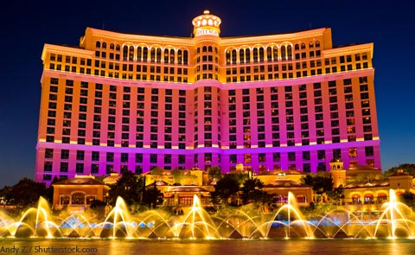
The Bellagio Hotel

Slide 4
Favourite movie

Slide 5
Sydney to Las Vegas
Flight time is 15 hours 56minutes
Return flight $1,543
Room rate cheapest is on Sunday $159/night, and $499 on Saturdays in September

Slide 6
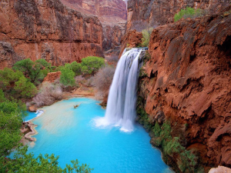
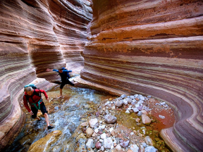
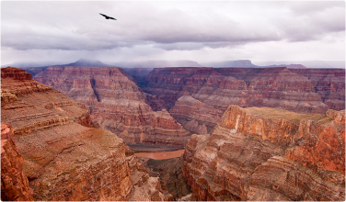
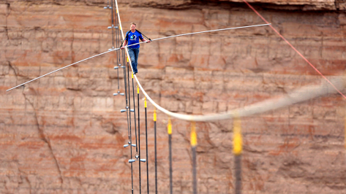
Visit the Grand Canyon 5 hour drive from Las Vegas to Grand Canyon

Slide 7
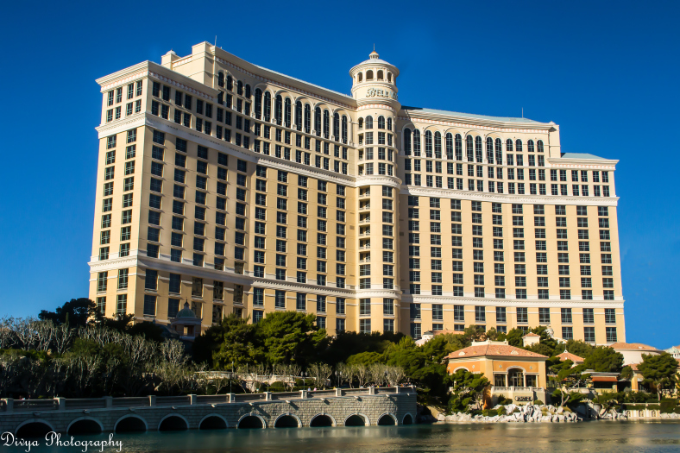
By Mitchell and Dwayne
August 2014

